Slide 1
University of Gujrat Department of Computer Science
Course Code : CS-252
Computer Organization and Assembly Language
Lecture # 1
Course Introduction

Slide 2
Purpose of the Course
To have a look at the Computer System at lower level of abstraction.
To understand the functions and working of the Computer System at a basic level.

Slide 3
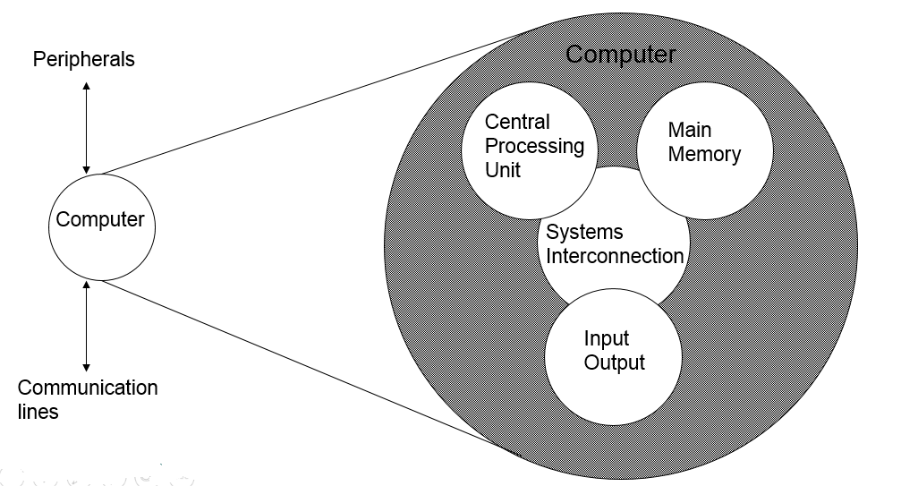
Up till now you have studied a computer as

Slide 4
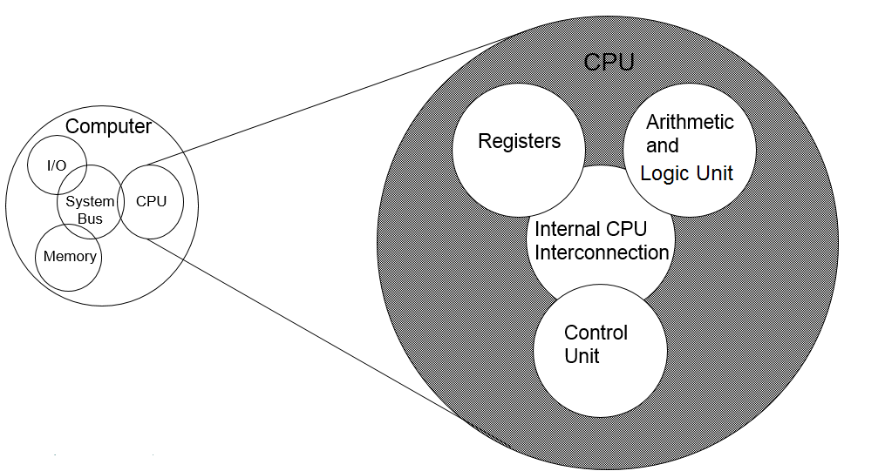
Now, You’ll have a deeper look..

Slide 5
Introduction to the Course
This course will have two parts
Part I : Computer Organization
Part II : ` Assembly Language

Slide 6
Part I
Computer Organization

Slide 7
Computer Organization
Computer Organization refers to operational units of the system together with their interconnection.

Slide 8
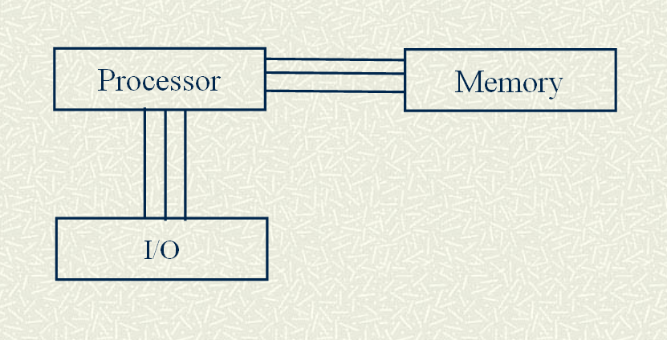
Basic Computer Organization
Interconnections between the components

Slide 9
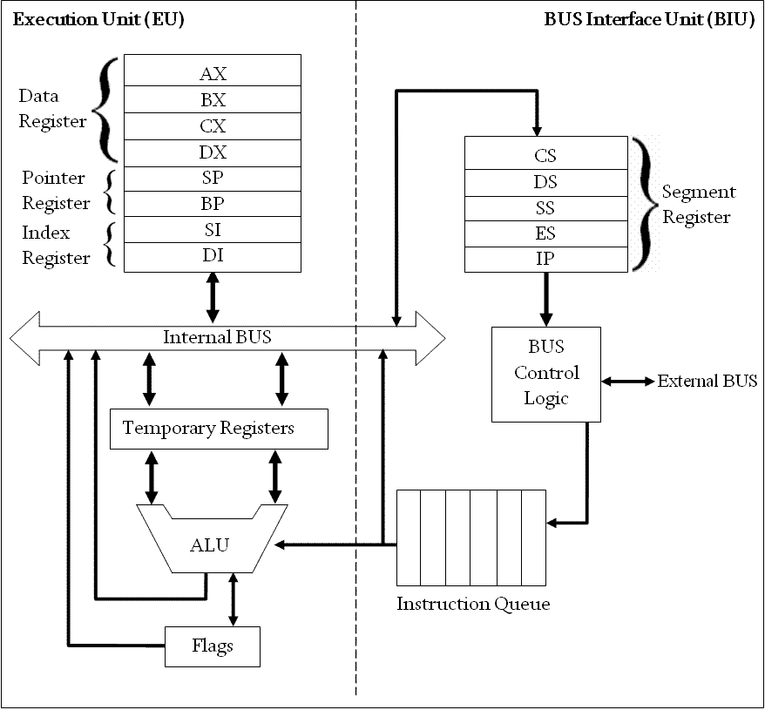
Inside a Microprocessor

Slide 10
Part II
Assembly Language

Slide 11
Assembly Language
Assembly Language is a low level programming language.
It has human readable instructions of the CPU.
On PCs, the assembly language looks like this
MOV AX,A
ADD AX,4

Slide 12
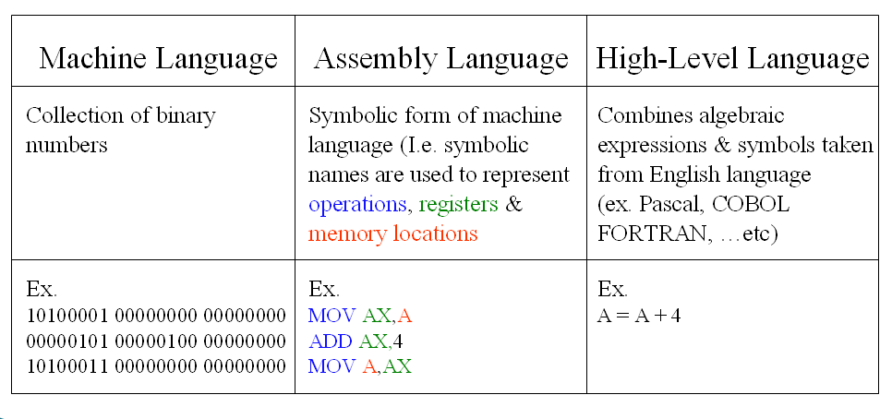
Programming Languages

Slide 13
Why Assembly Language ?
Assembly language helps to understand the functioning of computer system at a lower level
Compiler is a dumb software, the code produced by it is not an optimized code. It produces a lot of garbage and unnecessary stuff. In normal programs such garbage is acceptable but there are a situations where this loss is unbearable.

